Slide 1
Urticaria and Drug Eruptions
Presenters
Dr. Elimokozi Maleko
Dr. Patrick Mlowezi
Facilitator
Dr. Magdalena

Slide 2
Outline
Introduction
Epidemiology
Pathophysiology
Clinical presentation
Types and common conditions
Diagnosis
Treatment

Slide 3
Urticaria

Slide 4
Introduction
Urticaria and angioedema represent the same pathophysiologic process occurring at different levels of the skin
  Urticaria involves dilation of vascular structures in the superficial dermis
  Angioedema involves dermis and subcutaneous tissues.
Often appear together: ≈40% of patients reporting both
Affect >20% of the population at some time during their life span

Slide 5
Introduction…
Urticaria can occur on any area of the body as:
  Well-circumscribed wheals
  With erythematous raised serpiginous borders and
  Blanched centers that may coalesce to become giant wheals
  Intensely pruritic
  Frequently migrate around the body
  Leave no bruising or scarring
  Resolve within 24 hrs

Slide 6
Introduction…
Angioedema is marked by:
  Dramatic swelling
  More pain than pruritus
  A pruritic prodrome → minimal erythema (hours to days to resolve)

Slide 7
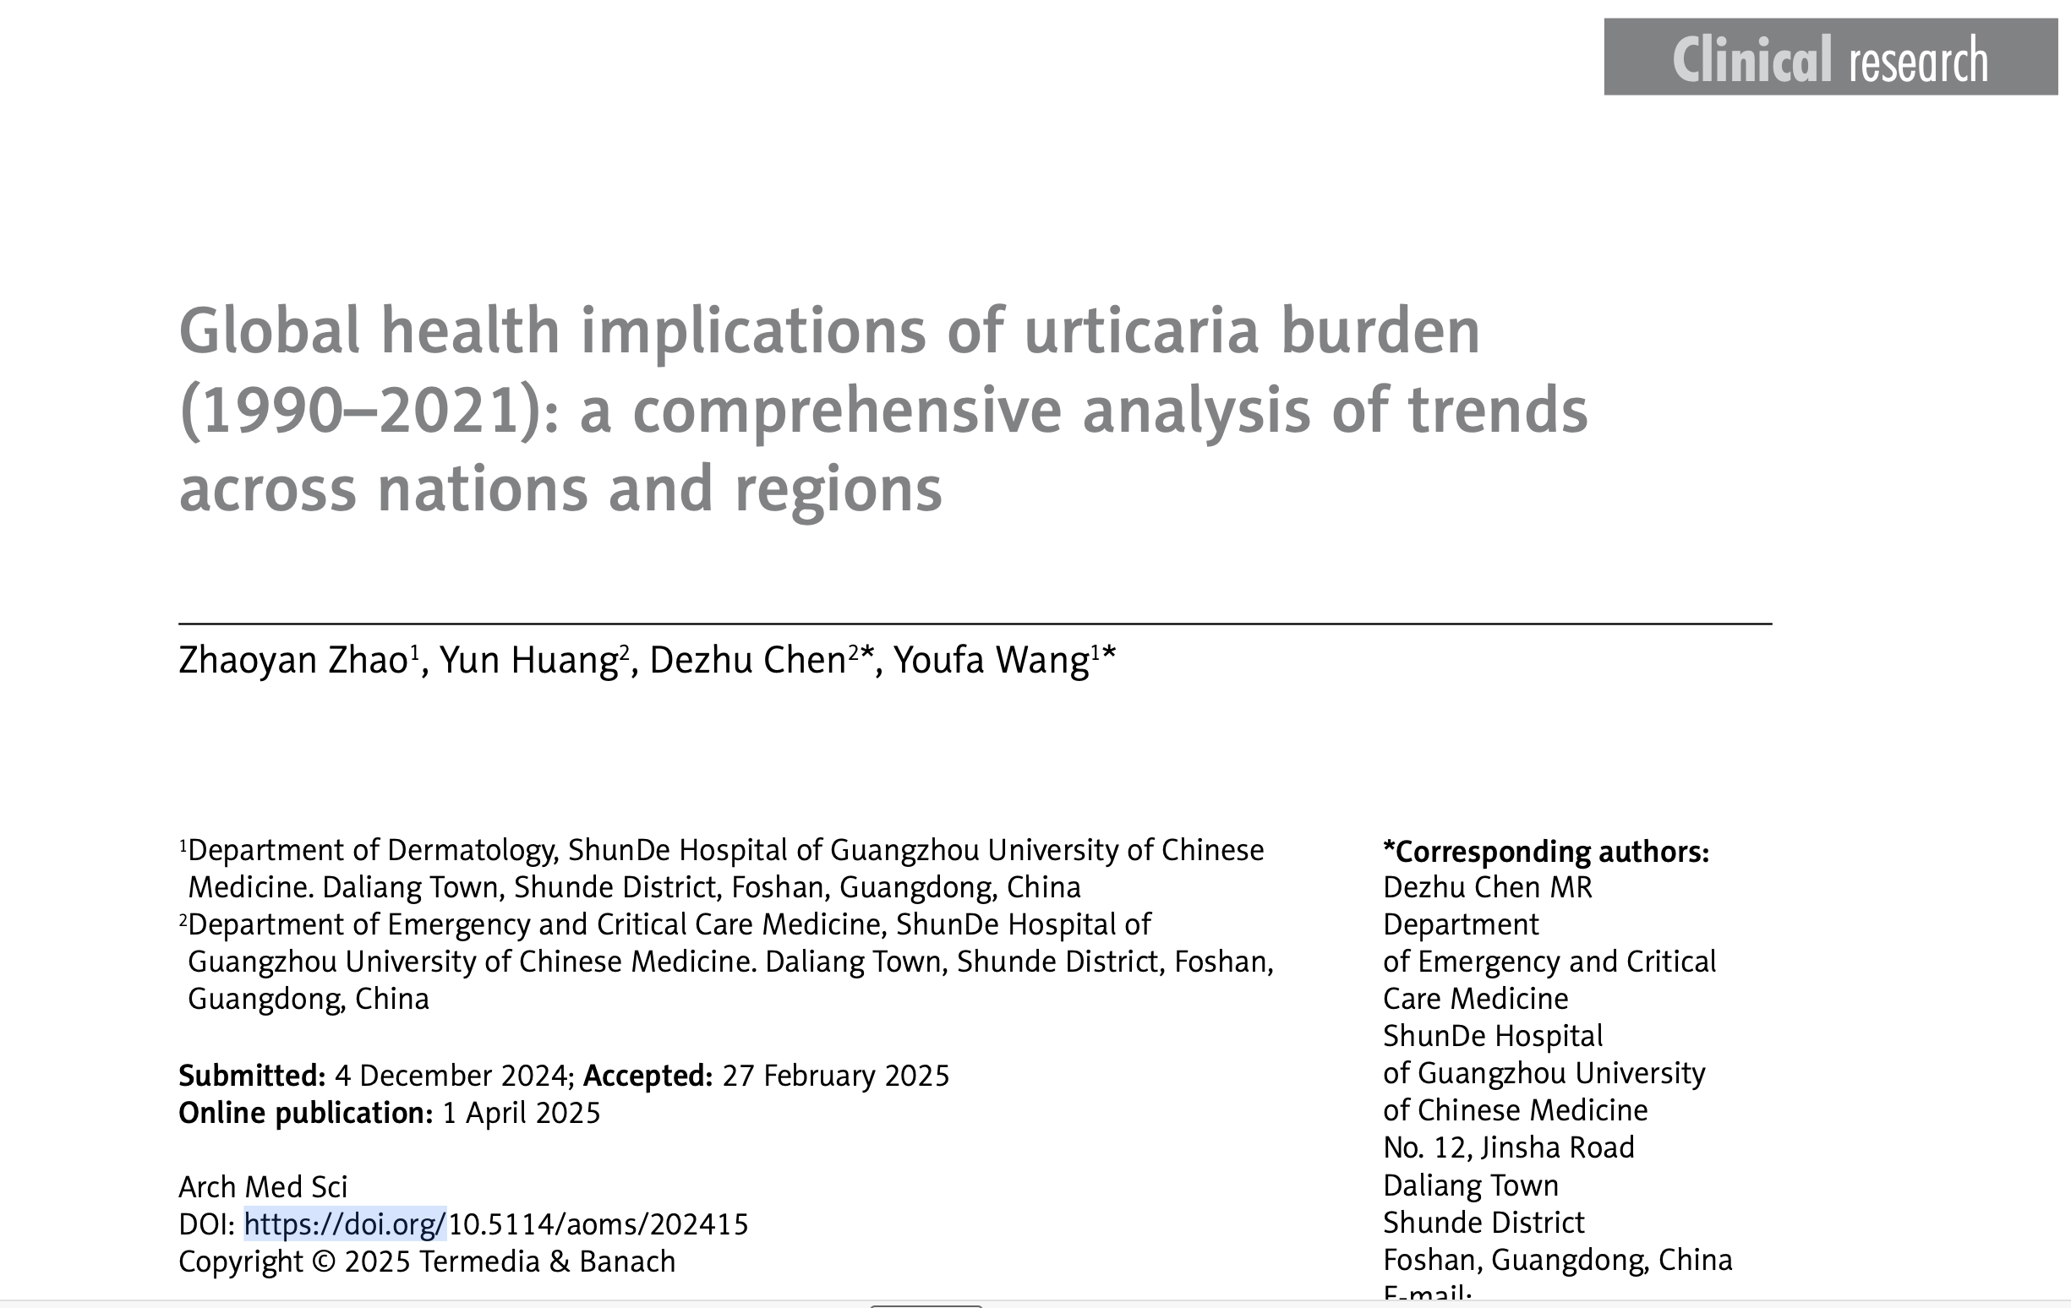
Epidemology

Slide 8

Global Burden
Overall increase in Prevalent cases (1990-2021) [48mil→66.8mil/ ASPR 866 – 868 per 100,000 population]
Female patients consistently reported higher rates
Peak age: 20 – 40 yrs
Incident cases increased from about 85 million to 117 million
The global age-standardized DALY rate –> 52.1 per 100,000 (2021)
Burden highest in low-middle SDI regions and lowest in high SDI areas

Slide 9
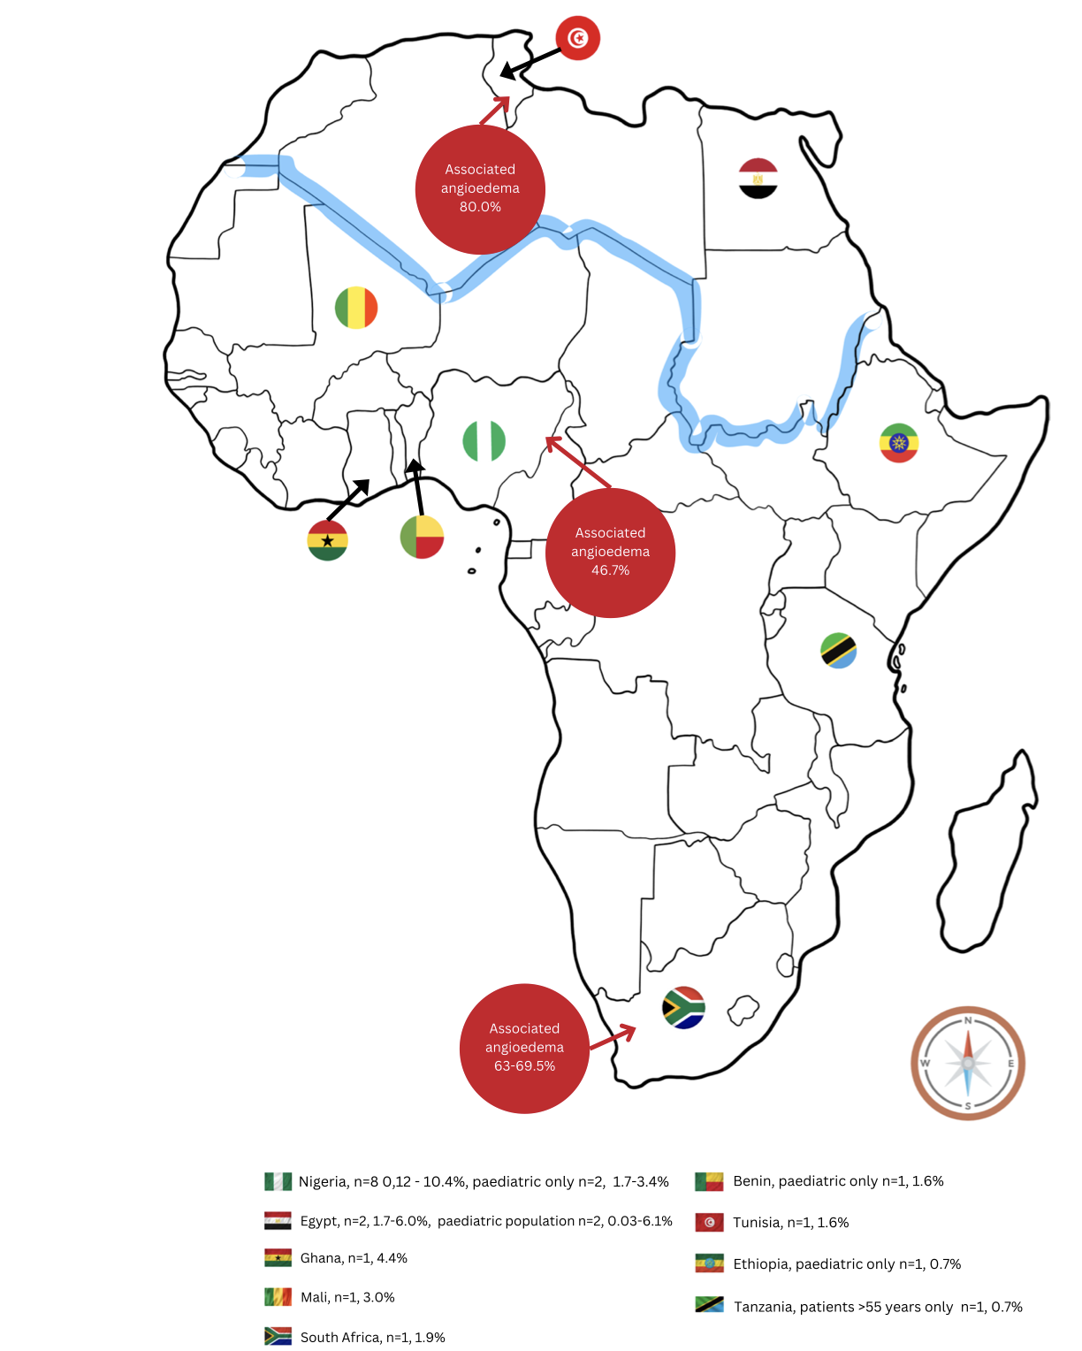
Africa
≈ 1.9% in Sub-sahara Africa
≈1% in Adult population
Cascia D et al, Chronic Urticaria in Africa, A Systematic Review, https://doi.org/10.1007/s40521-024-00380-x January 2025

Slide 10
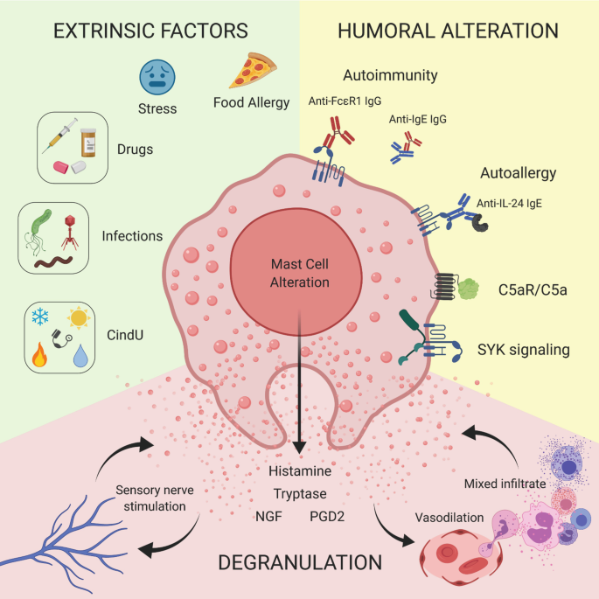
Pathophysiology
Triple response of Lewis
vasopermeability

Slide 11
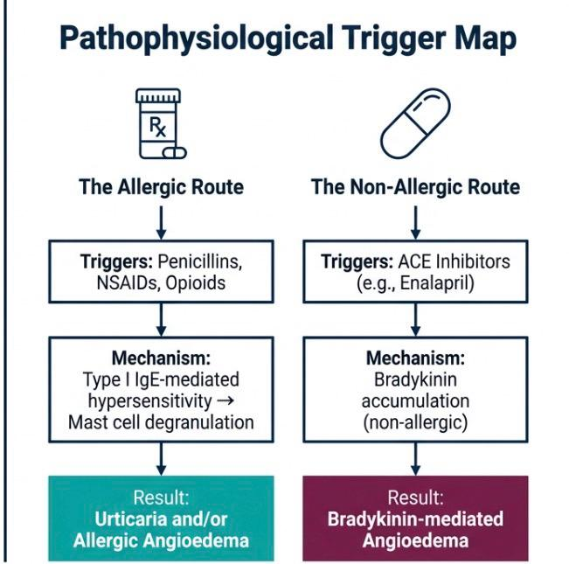

Slide 12
Clinical Presentation

Slide 13
Wheals
Distinctly Pruritic
solitary/confluent
Pattern
<2h/ 12hr-36hr Duration
Old lesions fading as new ones appear.
No Residual scaring Unless vasculitis involved
Angioedema
periorbital perioral
URTI → Laryngeal Obstruction
Distribution
Head to toe: Asymmetrical

Slide 14
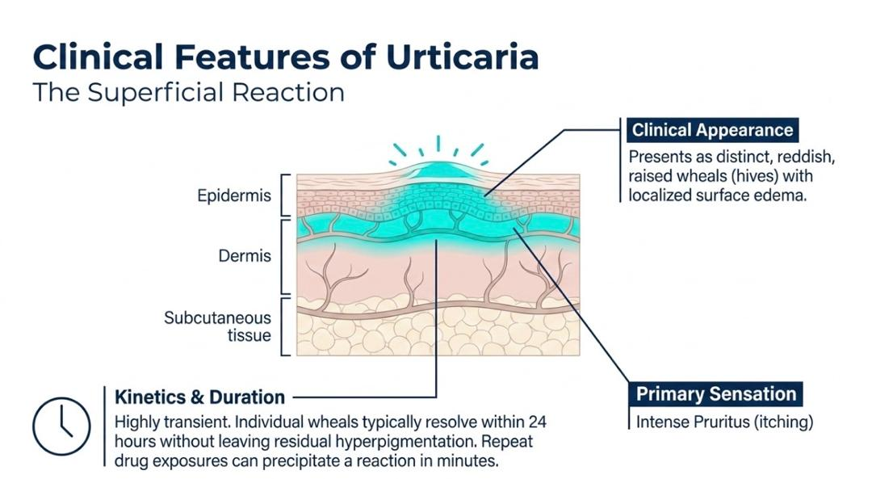

Slide 15
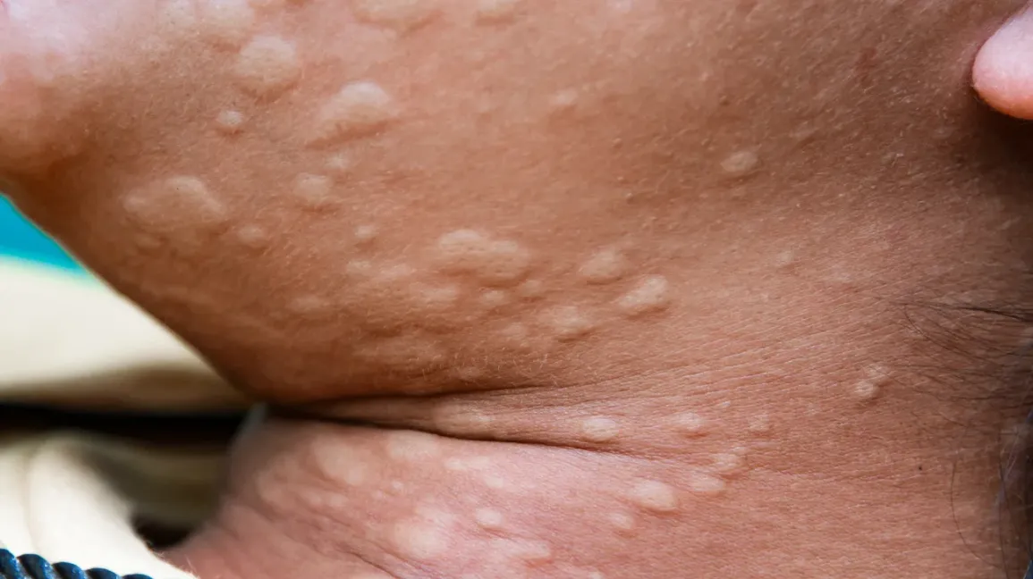
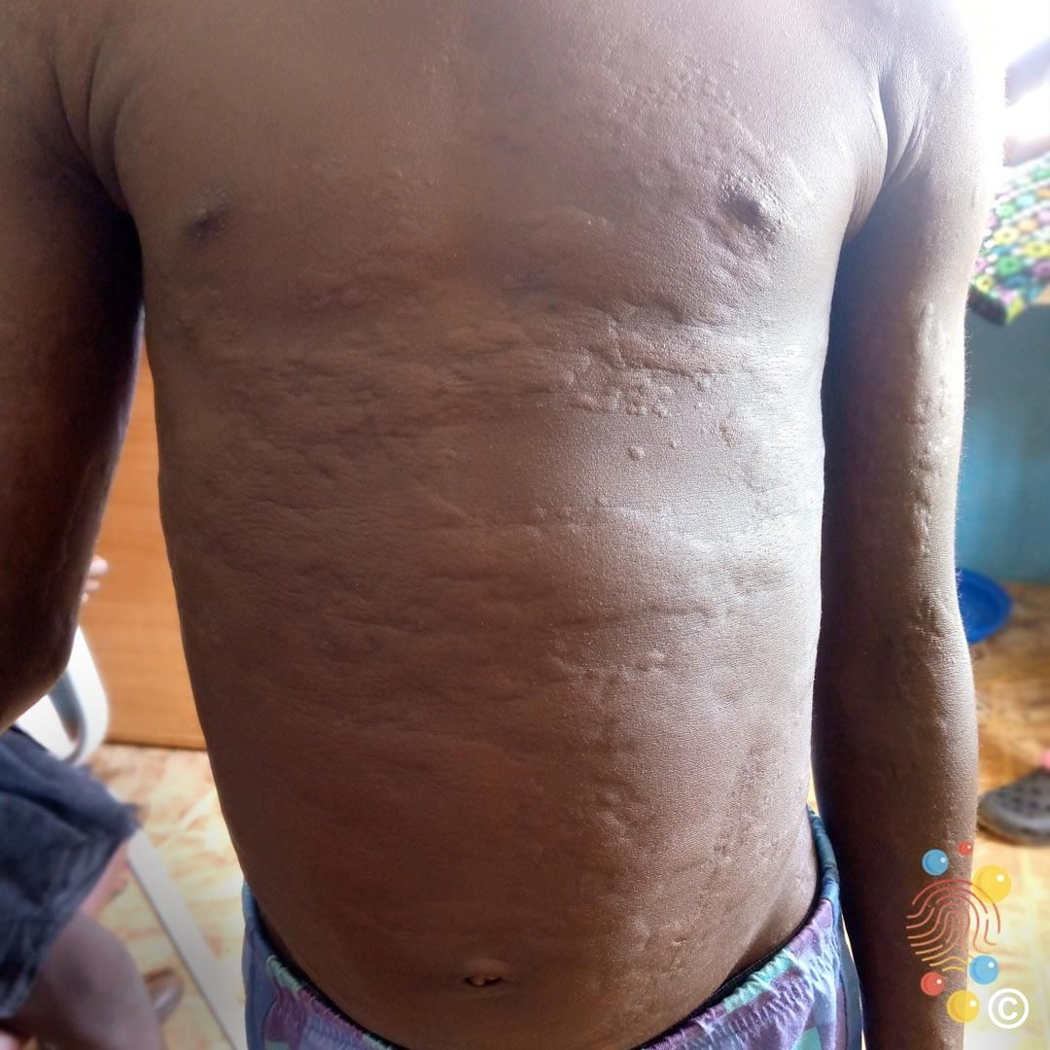
Wheals

Slide 16
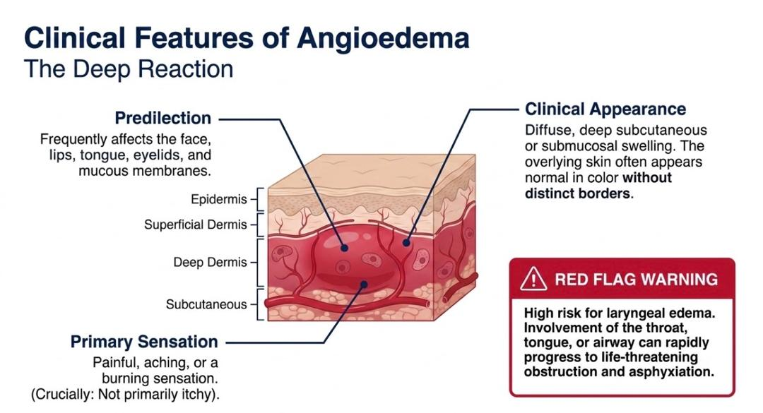

Slide 17
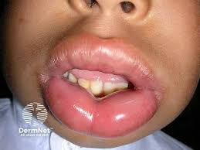
Perioral angioedema

Slide 18
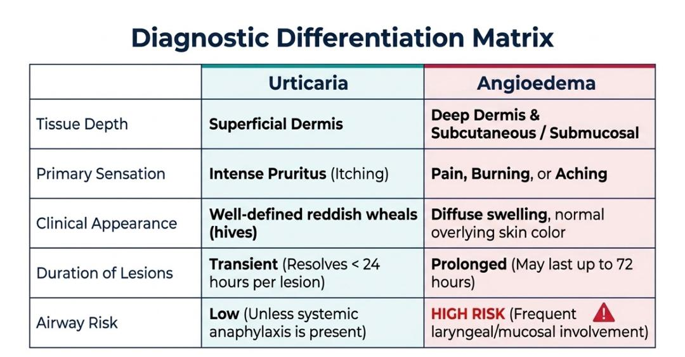

Slide 19
Classification of urticaria

Slide 20
Urticaria
Duration
Triggers
ACUTE<6WKS
CHRONIC >6 WKS
SPONTANEOUS
INDUCIBLE

Slide 21
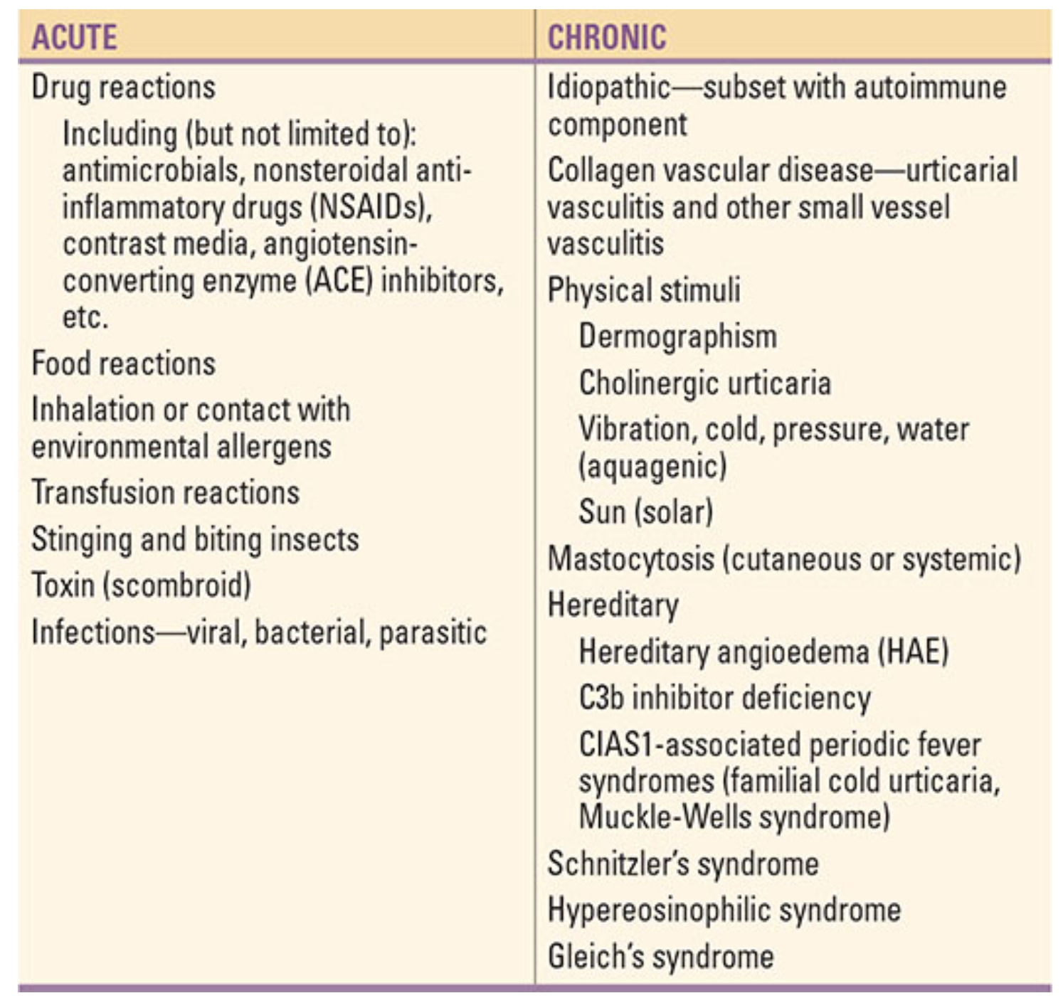
< 6weeks
> 6weeks
Notes:
Drugs: Penicillins, Cephalosporins, Sulfonamides, NSAIDs, ACEIs, Opioids, Vaccines

Slide 22
TYPE OF CHRONIC INDUCIBLE URTICARIA | TRIGGER/STIMULUS | CLINICAL FEATURES | PREVALENCE/NOTES | ASSOCIATED CONDITIONS
Dermatographism | Firm stroking of the skin | Linear wheal with surrounding erythema | 2–5% of population; peaks in 2nd–3rd decades; <5 years duration | Not influenced by atopy
Pressure Urticaria | Sustained pressure (e.g., straps, running, manual labor) | Delayed wheals at pressure sites | Often accompanies chronic idiopathic urticaria | Chronic idiopathic urticaria
Cholinergic Urticaria | Fever, hot bath/shower, exercise (↑ core body temperature) | Small (1–2 mm) pruritic wheals with large erythematous halos | Distinctive presentation; common in young adults | May coexist with vibratory urticaria
Exercise-Induced Anaphylaxis | Exercise (alone or after food ingestion) | Flushing, pruritus, urticaria → angioedema, vascular collapse | May involve IgE to α-5 gliadin (wheat component); not triggered by passive heating | IgE to wheat gliadin (α-5 gliadin)
Solar Urticaria | Exposure to specific UV/visible light wavelengths | | Urticaria localized to sun-exposed areas | Subdivided into 6 groups based on light spectrum sensitivity | None
Cold Urticaria | Low temperatures or cold objects | Local wheals→ vascular collapse during swimming | Can be acquired or inherited (familial cold autoinflammatory syndrome →NLRP3 mutation) | Familial cold autoinflammatory syndrome
Vibratory Urticaria | Vibration (occupational exposure or idiopathic) | Local urticaria and/or angioedema | Can be familial (mutation in ADGRE2) or idiopathic; | Familial vibratory urticaria (ADGRE2 mutation), cholinergic urticaria
Local Heat Urticaria | Local application of heat | Localized wheals at heat exposure site | Rare | None
Aquagenic Urticaria | Contact with water (any temperature) | Local urticaria | Rare; sometimes associated with polycythemia vera | polycythemia vera
Contact Urticaria | Direct contact with substances (e.g., latex) | Localized urticaria at site of contact | Stimulus-specific | Chemical sensitivity (e.g., latex allergy)

Slide 23
Diagnosis
History alone of self-limited episodes suffices in the setting of:
Acute disease triggered by
  Drug
  Environmental
  Food allergen
History-directed confirmatory skin testing or assay for serum allergen-specific IgE
Direct reproduction of lesion in physical urticaria is valuable
Labs: Only when indicated (CBC,ESR/CRP,ANA,Complement)

Slide 24
Diagnosis…
Red Flags – When to Investigate Further
Lesions >36 hours, painful, scarring → suspect urticarial vasculitis
  Do a biopsy: Look for cellular infiltration, nuclear debris, fibrinoid necrosis
Chronic angioedema without urticaria → check complement levels
Flushing and urticating papules → evaluate for mastocytosis
Travel history → assess for parasitic infections

Slide 25
Diagnosis…
Consider hereditary angioedema (HAE);
  Recurrent laryngeal edema
  No pruritis or urticaria
  Prominence of recurrent abdominal colicky
  Positive Family History

Slide 26
Treatment
First-Line Treatment for Most Urticarias
H1 Antihistamines Preferred Agents (non- or low-sedating):
  Loratadine, Desloratadine, Fexofenadine
  Cetirizine, Levocetirizine
Dose escalation: Up to 4× standard daily dose if needed
Sedating antihistamines (e.g., diphenhydramine):
  CNS side effects: drowsiness, impaired coordination
  Anticholinergic effects: visual disturbance, constipation

Slide 27
Treatment…
Add-On Therapies for Inadequate Response
H2 Antagonists:
  Ranitidine, Famotidine
CysLT1 Receptor Antagonists:
  Montelukast (10 mg/day)
  Zafirlukast (20 mg twice daily)

Slide 28
Treatment…
Second-Line & Advanced Treatments
  Monoclonal Antibodies
  Omalizumab: Anti-IgE; effective for chronic refractory urticaria
Other Agents (sedating but may help)
  Doxepin
  Cyproheptadine
  Hydroxyzine

Slide 29
Role of Glucocorticoids & Immunosuppressants
Not recommended:
  Topical steroids – ineffective
  Systemic steroids – generally avoided due to toxicity
Consider if:
  Pressure urticaria
  Vasculitic urticaria
  Refractory chronic urticaria
  Idiopathic angioedema
Add-on Immunomodulators:
  Hydroxychloroquine
  Dapsone
  Colchicine
Cyclosporine – for severe, treatment-resistant cases

Slide 30
Role of Glucocorticoids & Immunosuppressants...
Treatment of Bradykinin-Mediated Angioedema (HAE)
Acute Attacks:
  Plasma-derived or recombinant C1INH (C1 esterase inhibitor)
  Icatibant (bradykinin B2 receptor antagonist)
  Ecallantide (kallikrein inhibitor)
  FFP (fresh frozen plasma) if other agents unavailable

Slide 31
HAE Prophylaxis Options
  Lanadelumab (anti-kallikrein monoclonal antibody)
  Plasma-derived C1INH
  Attenuated androgens (stimulate C1INH production)
  ε-Aminocaproic acid (antifibrinolytic)
    Contraindicated in thrombotic risk patients

Slide 32
ACE Inhibitor–Induced Angioedema & Acquired C1INH Deficiency
  ACE Inhibitor–Induced Angioedema: Stop culprit
  Acquired C1INH Deficiency:
  Treat underlying autoimmune disease or malignancy

Slide 33
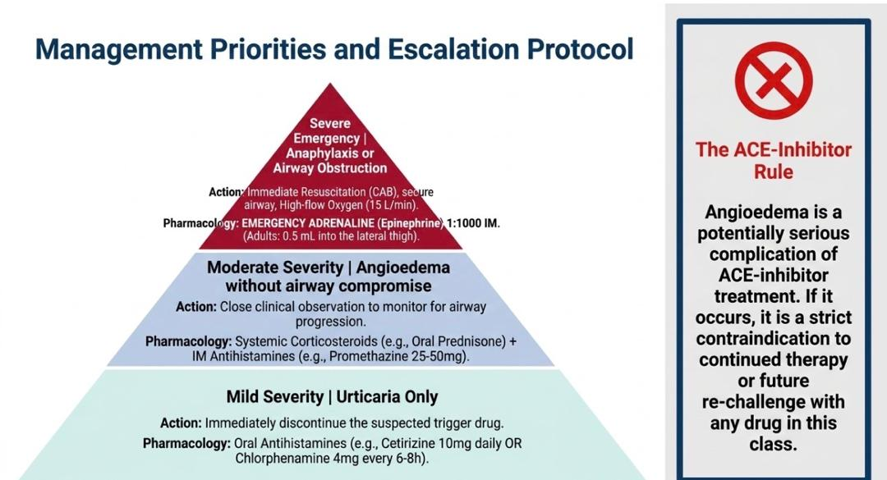

Slide 34
Drug Eruptions
Any unwanted change in the skin, skin appendages or mucous membranes due to a drug; and has any unpredicted and harming reaction observed due to a drugs given at doses within the normal limits by the World Health Organisation
The pre-requisites for a reaction
  The dosage of the drug was within the normal limits
  The reaction was unpredictable
  The reaction was harmful for the patient

Slide 35
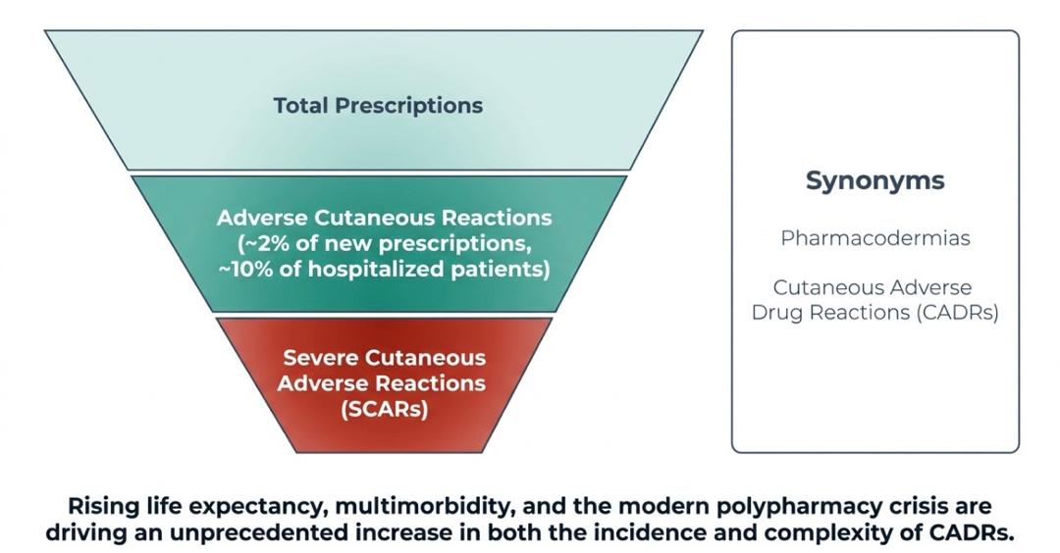

Slide 36
Epidemiology
Internationally 2-3% of in patients
Severe and potentially life thretening eruptions occurs in 1 in 1000 hospital patients
Common in:
  Women
  Elderly
  Immunocompromised patients

Slide 37









Predisposing Factors
Abnormal drug metabolism
Host disease
Elderly
Polypharmacy
Previous hypersensitivity
Notes:
eg: in HIV infection, the incidence of cutaneous adverse drug reactions (morbilliform or urticarial rashes) increases as immune function deteriorates

Slide 38
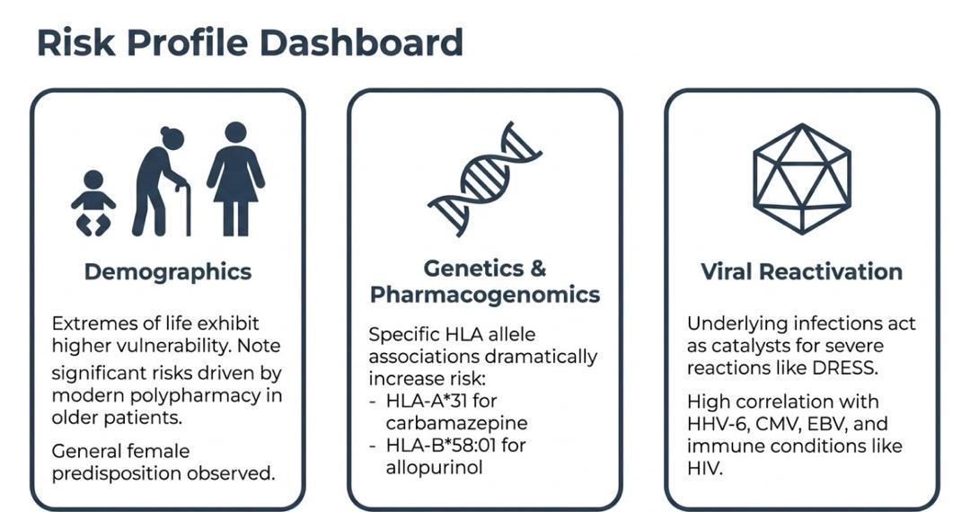

Slide 39
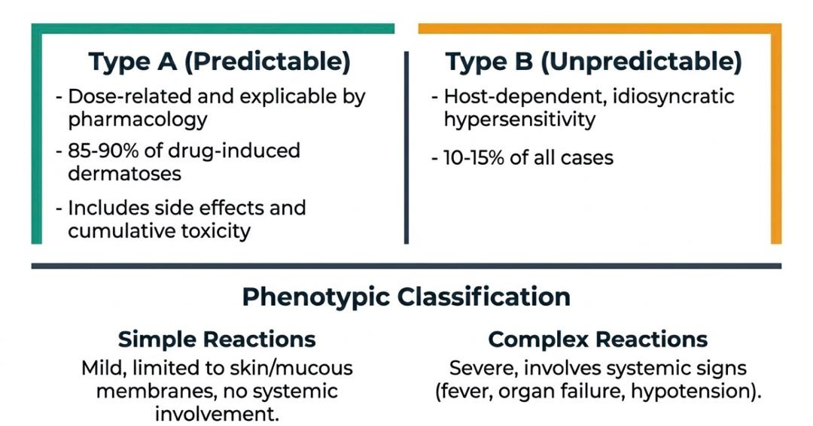
Classification of Drug Eruptions

Slide 40
Pathophysiology
Immunologically mediated
Type I - Immunoglobulin E (IgE)-dependent reactions
  urticaria, angioedema, and anaphylaxis
  Drugs: Quinine, salicylates, chlorpromazine, and sulfonamides
Type II - Cytotoxic reactions
  hemolysis and purpura
  Drugs: Penicillin, cephalosporins, sulfonamides, and rifampin
Type III - Immune complex reactions
  Vasculitis and serum sickness
  Drugs: Quinine, salicylates, chlorpromazine, and sulfonamides
Type IV - Delayed-type reactions with cell-mediated hypersensitivity
  contact dermatitis, exanthematous reactions, and photoallergic reactions
  Not dose-dependent
  Begins 7-20 days after the medication is started
  Involve blood or tissue eosinophilia
  Recurs if drugs chemically related to the causative agent are administered

Slide 41
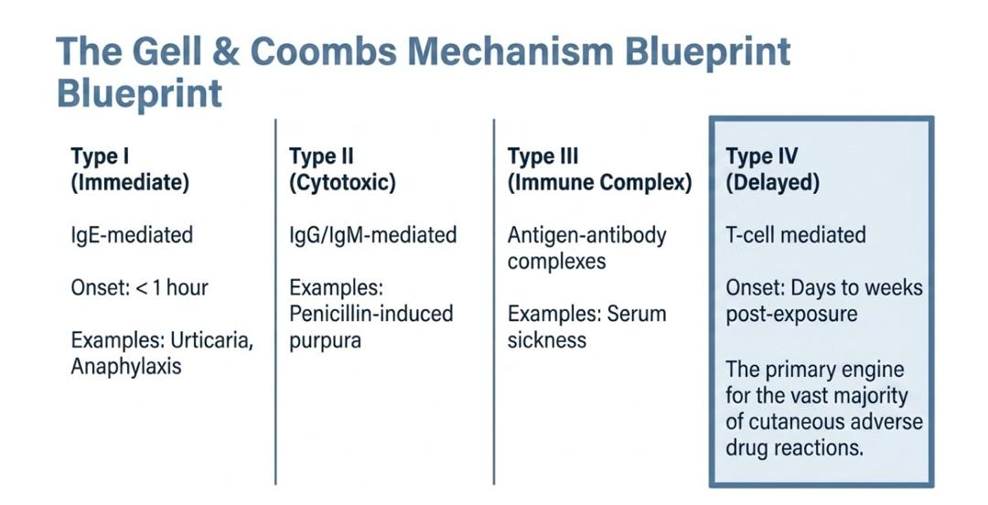

Slide 42
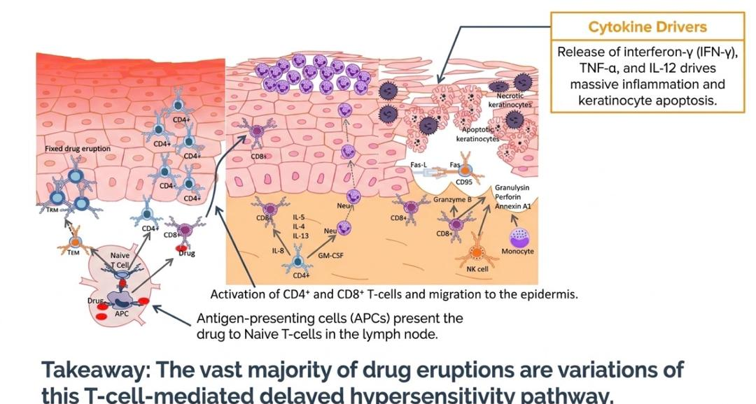

Slide 43
Pathophysiology…
Non-Immunologically Mediated
Accummulation
  Eample: Argyria (blue-gray discoloration of skin and nails) observed with use of silver nitrate nasal sprays
Adverse effects
  Normal but unwanted effects of a drug
  Example:
    Antimetabolite chemotherapeutic agents, such as cyclophosphamide, are associated with hair loss
Idiosyncratic reactions
  Unpredictable and not explained by the pharmacologic properties of the drug
  Examples:
    Individual with infectious mononucleosis who develops a rash when given ampicillin
    Candidiasis frequently occurs with antibiotic therapy
Intolerance
  Occurs in patients with altered metabolism
  Example:
    Individuals who are slow acetylators of the enzyme N-acetyltransferase are more likely than others to develop drug-induced lupus in response to procainamide

Slide 44
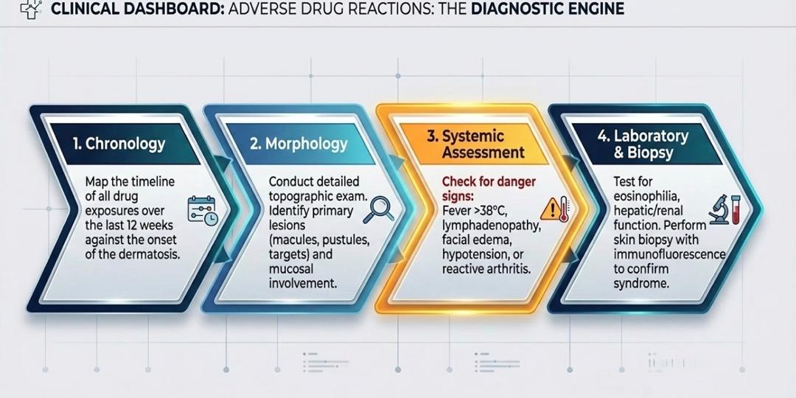
Diagnostic approach
Medication history
Timing of initial drug adminstration and onset of symptoms
Types and distribution of the rash

Slide 45
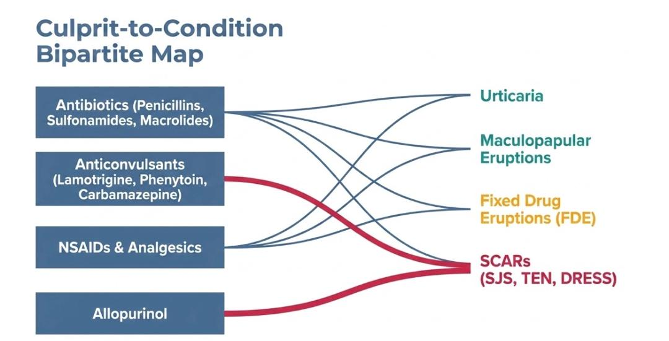

Slide 46
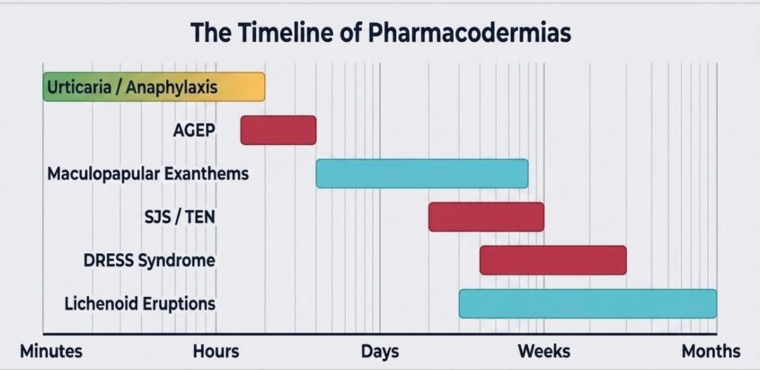

Slide 47
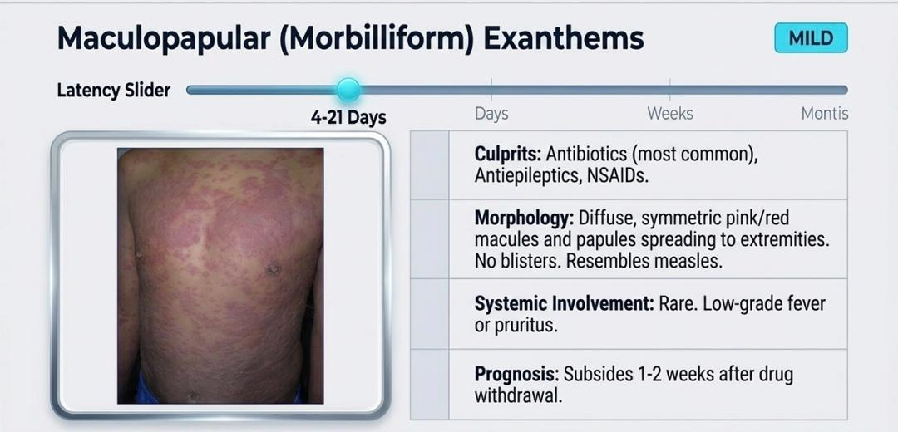
Notes:
More on the Torso and Extremities (Measles – like)

Slide 48
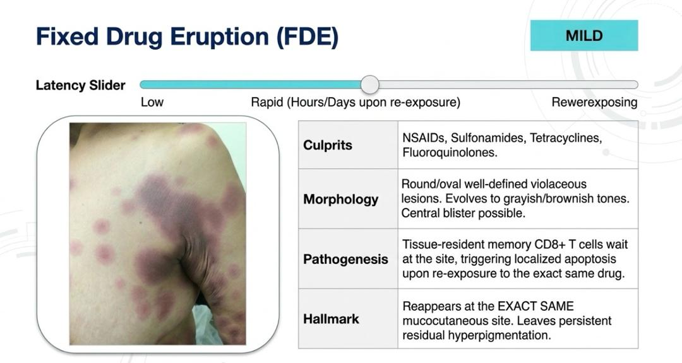

Slide 49
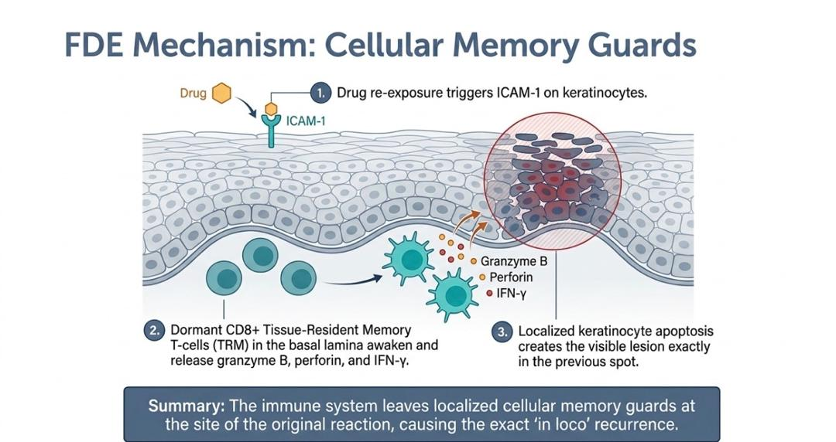

Slide 50
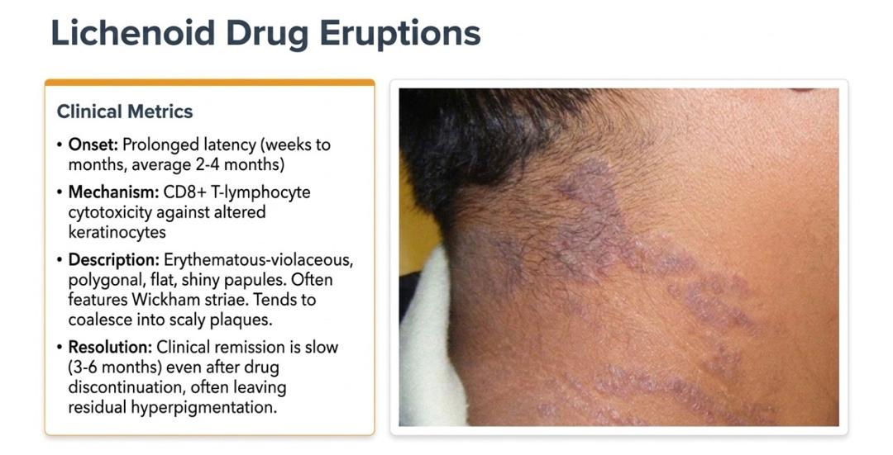

Slide 51
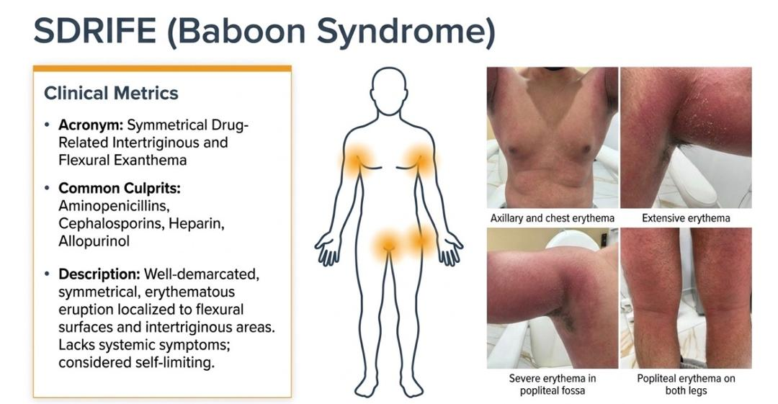

Slide 52
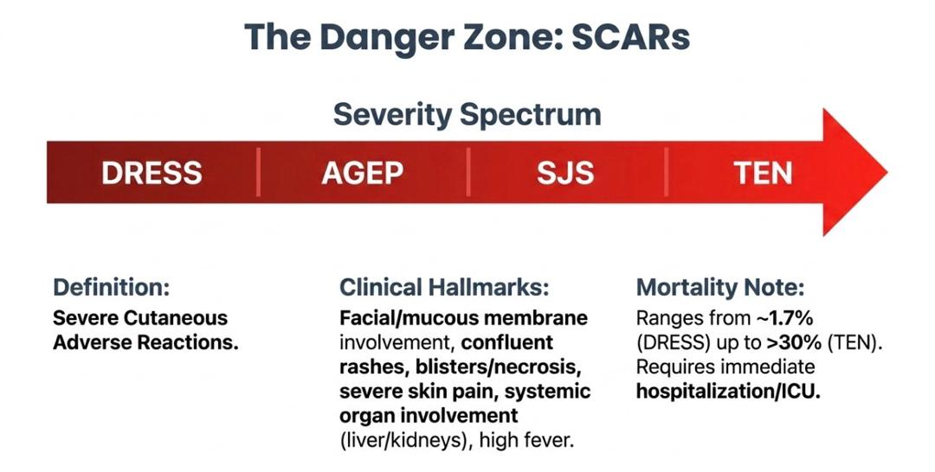
Notes:
CRIMSON ZONE (Deep Red Color) – Emergency/Life-Threatening: Require immediate drug withdrawal and aggressive supportive care

Slide 53
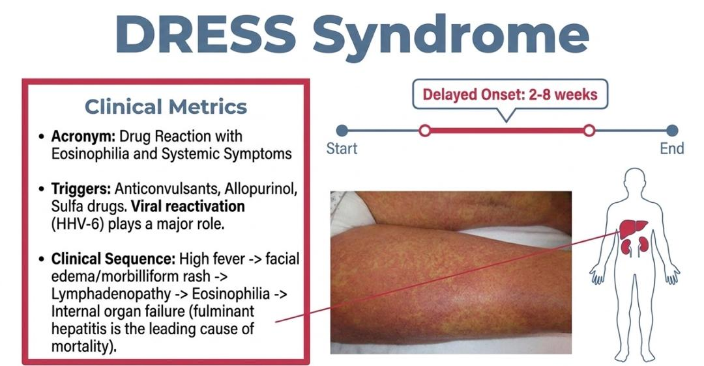

Slide 54
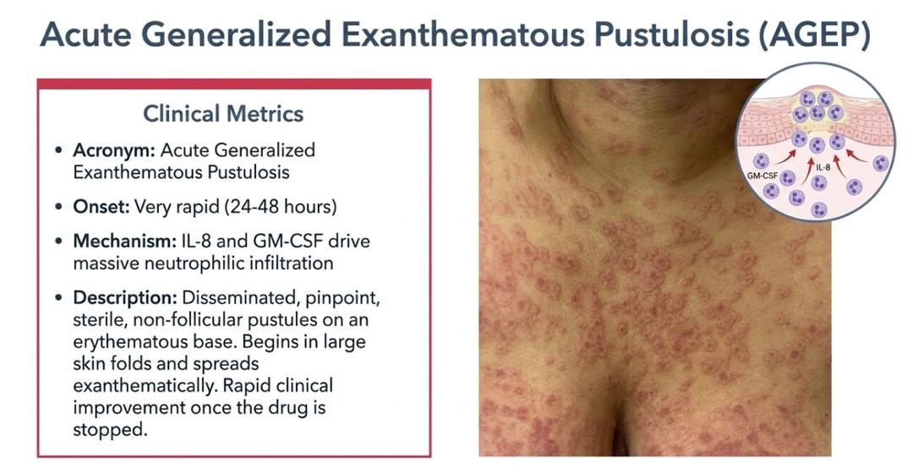

Slide 55
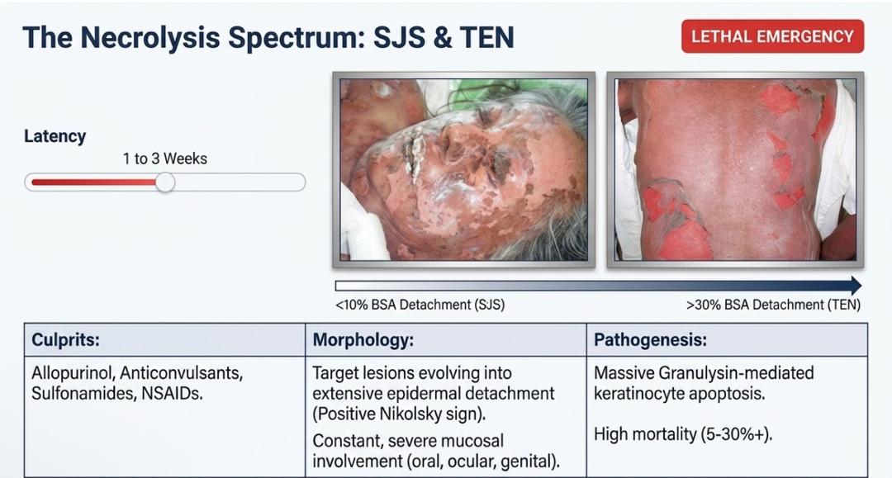
Notes:
SJS/TEN Overlap (10 – 30%)

Slide 56
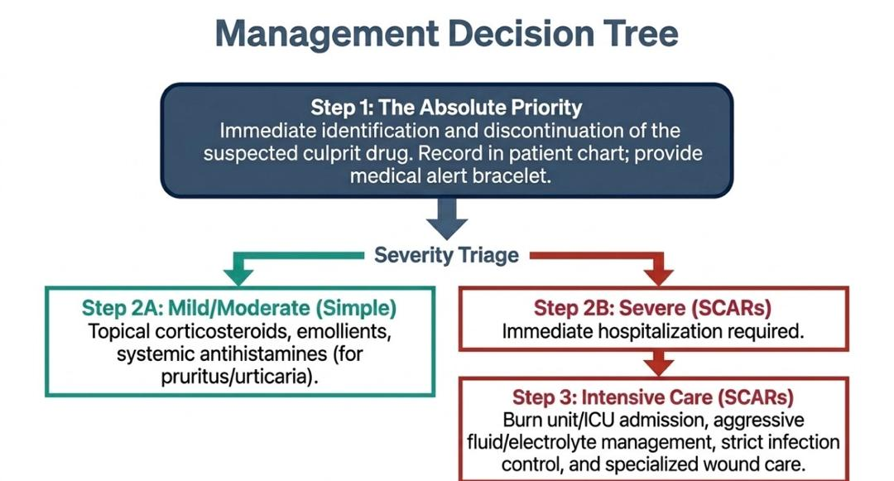
Management of Simple vs Severe Drug Eruptions

Slide 57
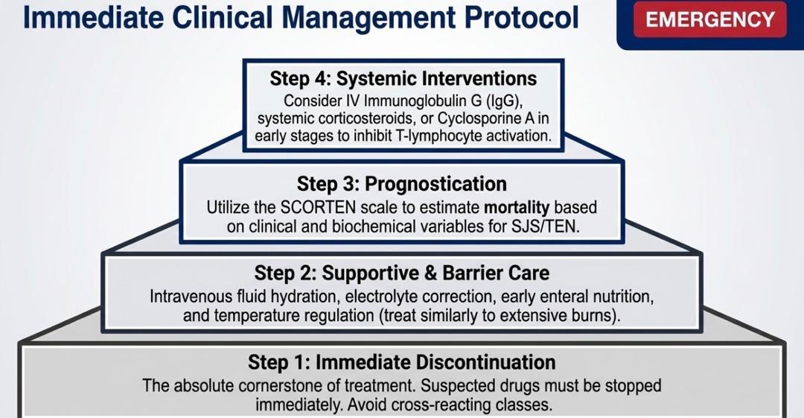

Slide 58
Treatment
These patients require immediate in-hospital management- ICU care
Early identification and withdrawal of the offending agent
Check for Nikolsky sign (If positive, progressive- corticosteroids)

Slide 59
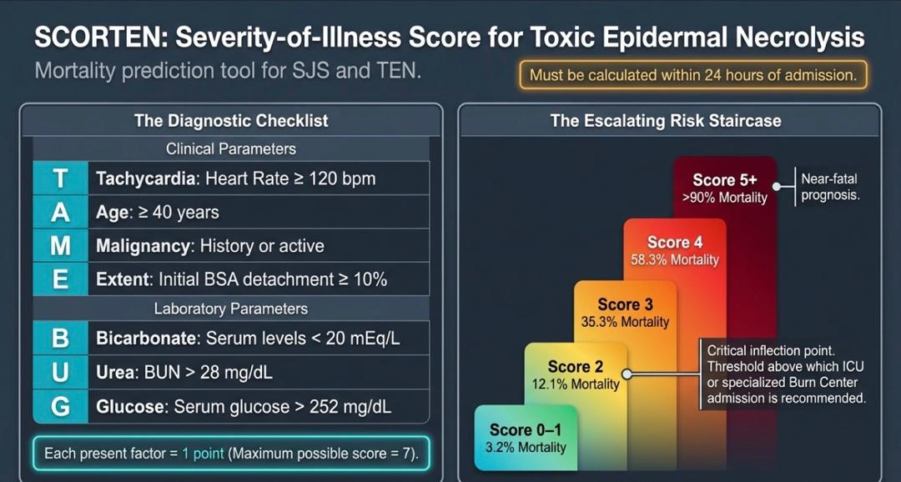

Slide 60
Supportive care for SJS/TEN
Wound care
  Non adherent nanocrystalline gauze materials (containing silver) used to cover the denuded skin
  Debridement of exfoliating skin for necrotic plaque (saline water bath and antibiotic cream application)
Fluid and electrolyte management
  Adequate hydration is important
  Calculated with formula: 2 mL/kg of body weight x % of body skin area skin detachment
Nutritional support
  Encourage Oral feeding
Albumin replacement
Pain control
  Mild pain (intensity <4) can be treated with nonopioid analgesics (eg: paracetamol/acetaminophen, ibuprofen)
  For moderate to severe pain (≥4)- Opioids

Slide 61
Supportive care for SJS/TEN…
Prevention and treatment of infections with systemic antibiotics are given routinely
Sterile handling and reverse-isolation procedures are performed routinely
Repeated cultures of the skin, blood, catheters, gastric and urinary tubes should be obtained at 48-hour intervals
Temperature management- cover the patient to keep them warm
Mucosal involvement- Healing process in this condition is slowed down thus increased chances of developing candida infections in mucosal surfaces

Slide 62
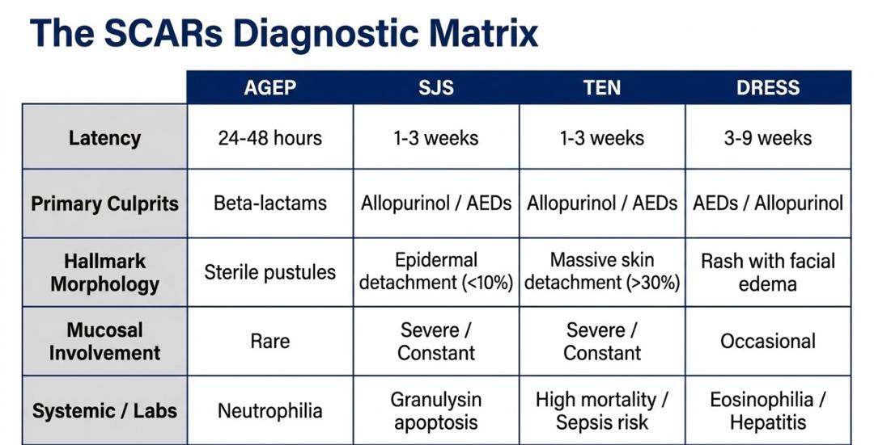

Slide 63
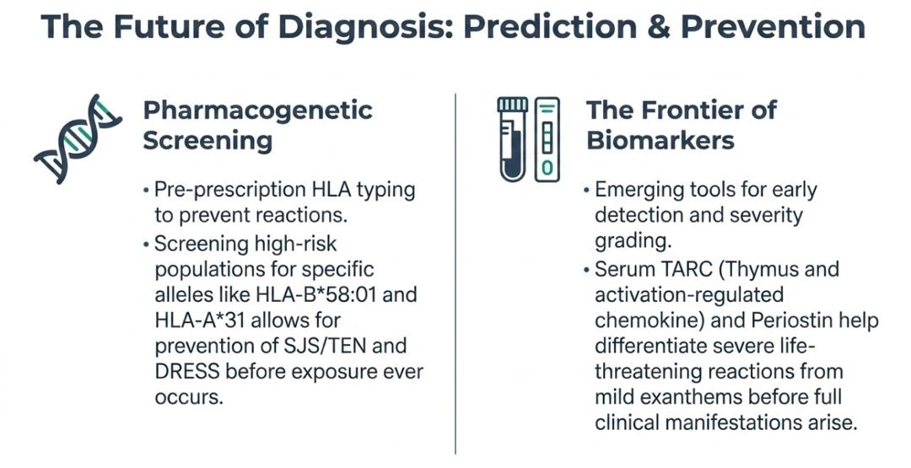

Slide 64
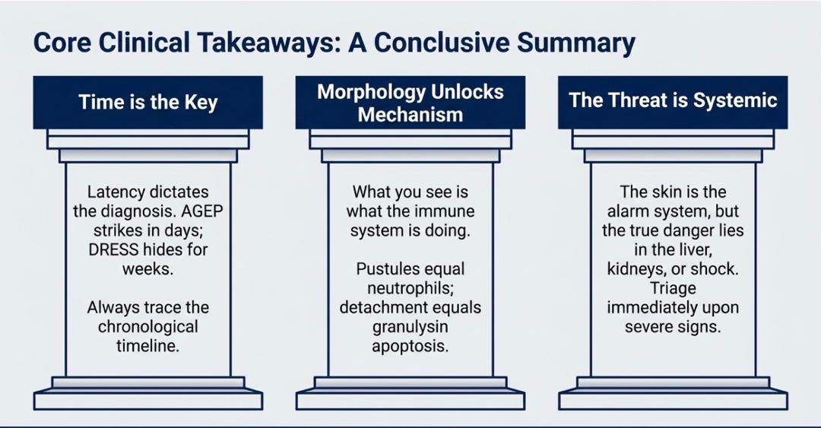

Slide 65
References
Kang S, Amagai M, Bruckner AL, Enk AH, Margolis DJ, McMichael AJ, et al., editors. Fitzpatrick’s Dermatology. 9th ed. New York: McGraw-Hill Education; 2019
Bolognia JL, Schaffer JV, Cerroni L, editors. Dermatology. 5th ed. Philadelphia: Elsevier; 2024.
Griffiths CEM, Barker J, Bleiker T, Chalmers R, Creamer D, editors. Rook’s Textbook of Dermatology. 10th ed. Hoboken (NJ): Wiley-Blackwell; 2024.
Zuberbier T, Abdul Latiff AH, Abuzakouk M, Aquilina S, Asero R, Baker D, et al. The international guideline for the definition, classification, diagnosis and management of urticaria. Allergy. 2025;80(2):303-367.
Hall JC, Hall BJ, editors. Cutaneous Drug Eruptions: Diagnosis, Histopathology and Therapy. 1st ed. London: Springer; 2015.
Creamer D, Walsh SA, Dziewulski P, Exton LS, Lee HY, Dart JKG, et al. British Association of Dermatologists guidelines for the management of people with chronic urticaria 2021. Br J Dermatol. 2022;186(3):399-411.

